Slide 1
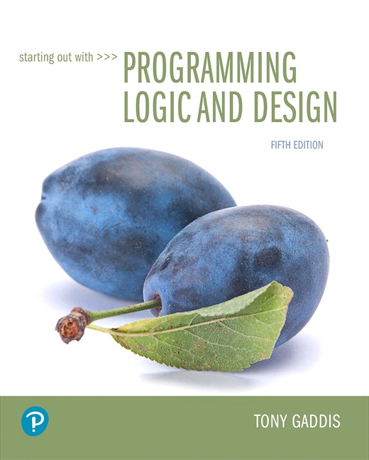
Starting out with Programming Logic and Design
Fifth Edition
Chapter 7
Input Validation
Copyright © 2016, 2013, 2010 Pearson Education, Inc. All Rights Reserved
Notes:
If this PowerPoint presentation contains mathematical equations, you may need to check that your computer has the following installed:
1) MathType Plugin
2) Math Player (free versions available)
3) NVDA Reader (free versions available)

Slide 2
Learning Objectives
7.1 Garbage In, Garbage Out
7.2 The Input Validation Loop
7.3 Defensive Programming
7.4 Focus on Languages: Java, Python, and C++

Slide 3
7.1 Garbage In, Garbage Out (1 of 2)
If a program reads bad data as input, it will produce bad data as output
Programs should be designed to accept only good data
Input Validation
All input should be inspected before processing
If it’s invalid, it should be rejected and the user should be prompted to enter the correct data

Slide 4
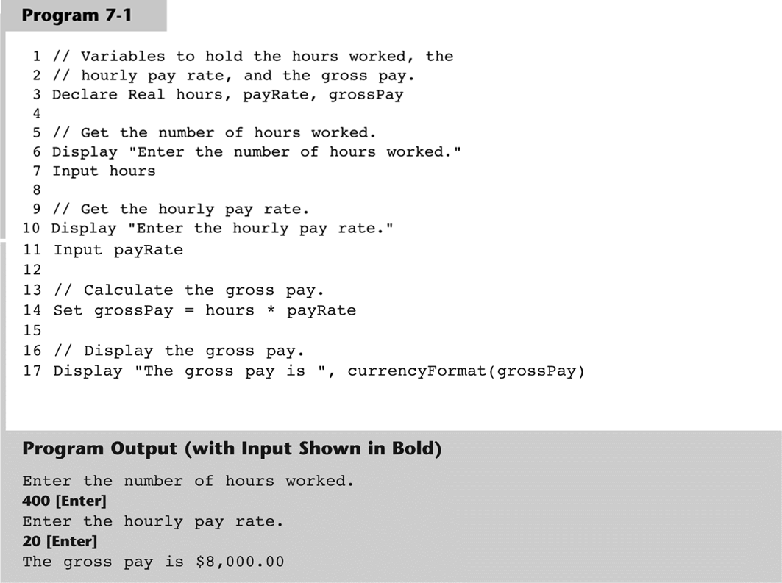
7.1 Garbage In, Garbage Out (2 of 2)

Slide 5
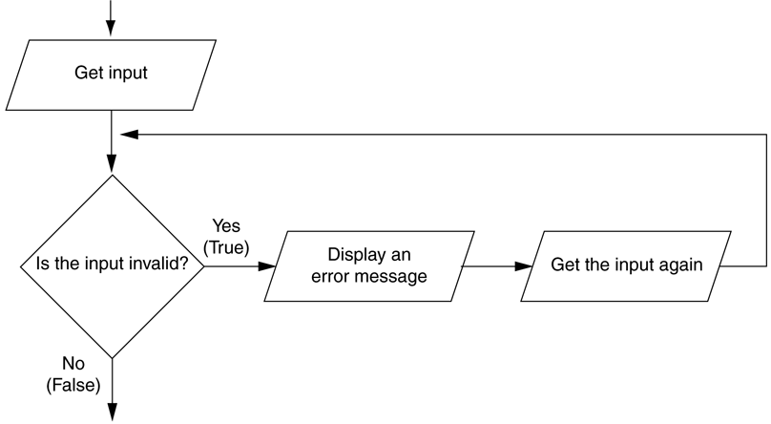
7.2 The Input Validation Loop (1 of 3)
Input validation is commonly done with a loop that iterates as long as input is bad
Figure 7-1 Logic containing an input validation loop

Slide 6
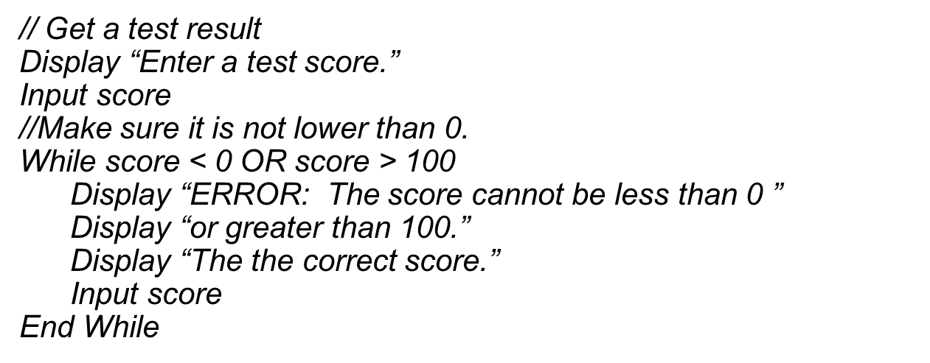
7.2 The Input Validation Loop (2 of 3)
Priming read is the first input to be tested

Slide 7
7.2 The Input Validation Loop (3 of 3)
Writing Validation Functions
For complex validation, it is recommended to write a function.
This process can make the code look cleaner
Validating String Input
Some strings must be validated such as those programs that ask for a specific string input like “yes”
Or programs that specify a string to be a specific length like password validation

Slide 8
7.3 Defensive Programming (1 of 2)
Input validation is defensive programming
The practice of anticipating both obvious and unobvious errors that can happen
Types of errors to consider
Empty input, where a user accidentally hits enter before entering data
The user enters the wrong type of data

Slide 9
7.3 Defensive Programming (2 of 2)
Common errors to be aware of
State abbreviations should be 2-character strings
Zip codes should be in the proper format of 5 or 9 digits
Hourly wages and salary amounts should be numeric values and within ranges
Dates should be checked
Time measurements should be checked
Check for reasonable numbers

Slide 10
7.4 Focus on Languages: Java

Slide 11
7.4 Focus on Languages: Java (1 of 2)
import java.util.Scanner;
public class InputValidation
{
public static void main(String[] args)
{
// Create a Scanner object for keyboard input.
Scanner keyboard = new Scanner(System.in);
// Local variable
String doAnother;
do
{
// Calculate and display a retail price.
showRetail();
// Do this again?
System.out.print("Do you have another item? (Enter y for yes): ");
doAnother = keyboard.next();
} while (doAnother.equals("y") || doAnother.equals("Y"));
}
Continued…

Slide 12
// The showRetail module gets an item's wholesale cost
// from the user and displays its retail price.
public static void showRetail()
{
// Create a Scanner object for keyboard input.
Scanner keyboard = new Scanner(System.in);
// Local variables
double wholesale, retail;
// Constant for the markup percentage
final double MARKUP = 2.5;
// Get the wholesale cost.
System.out.print("Enter an item's wholesale cost: ");
wholesale = keyboard.nextDouble();
// Validate the wholesale cost.
while (wholesale < 0)
{
System.out.println("The cost cannot be negative. Please");
System.out.print("enter the correct wholesale cost: ");
wholesale = keyboard.nextDouble();
}
// Calculate the retail price.
retail = wholesale * MARKUP;
// Display the retail price.
System.out.println("The retail price is $" + retail);
}
}
Program Output
Enter an item's wholesale cost: -1 The cost cannot be negative. Please enter the correct wholesale cost: 1.50 The retail price is $3.75 Do you have another item? (Enter y for yes): n

Slide 13
7.4 Focus on Languages: Python

Slide 14
7.4 Focus on Languages: Python (1 of 2)
# This program calculates retail prices.
# MARK_UP is used as a global constant for
# the markup up percentage.
MARK_UP = 2.5
# The main function
def main():
# Variable to control the loop.
another = 'y'
# Process one or more items.
while another == 'y' or another == 'Y':
# Display an item's retail price.
show_retail()
# Do this again?
another = input('Do you have another item? ' +
'(Enter y for yes): ') Continued…

Slide 15
# The show_retail function gets an item's wholesale
# cost and displays the item's retail price.
def show_retail():
# Get the item's wholesale cost.
wholesale = float(input("Enter the item's wholesale cost: "))
# Validate the wholesale cost.
while wholesale < 0:
print('ERROR: the cost cannot be negative.')
wholesale = float(input('Enter the correct wholesale cost: '))
# Calculate the retail price.
retail = wholesale * MARK_UP
# Display the retail price.
print('The retail price is $', format(retail, '.2f'))
# Call the main function.
main()
Program Output
Enter the item's wholesale cost: -.50
ERROR: The cost cannot be negative.
Enter the correct wholesale cost: 0.50
The retail price is $ 1.25.
Do you have another item? (Enter y for yes): n

Slide 16
7.4 Focus on Languages: C++

Slide 17
7.4 Focus on Languages: C++ (1 of 2)
#include <iostream>
#include <string>
using namespace std;
// Function prototype
void showRetail();
int main()
{
// Local variable
string doAnother;
do
{
// Calculate and display a retail price.
showRetail();
// Do this again?
cout << "Do you have another item? (Enter y for yes.)" << endl;
cin >> doAnother;
} while (doAnother == "y" || doAnother == "Y");
return 0;
}
Continued…

Slide 18
// The showRetail function gets an item's wholesale cost
// from the user and displays its retail price.
void showRetail()
{
// Local variables
double wholesale, retail;
// Constant for the markup percentage
const double MARKUP = 2.5;
// Get the wholesale cost.
cout << "Enter an item's wholesale cost." << endl;
cin >> wholesale;
// Validate the wholesale cost.
while (wholesale < 0)
{
cout << "The cost cannot be negative. Please" << endl;
cout << "enter the correct wholesale cost." << endl;
cin >> wholesale;
}
// Calculate the retail price.
retail = wholesale * MARKUP;
// Display the retail price.
cout << "The retail price is $" << retail << endl;
}
Program Output
Enter an item's wholesale cost: -1 The cost cannot be negative. Please enter the correct wholesale cost: 1.50 The retail price is $3.75 Do you have another item? (Enter y for yes): n

Slide 19

Copyright

